Slide 1
ELKS LEADERSHIP TRAINING
Presented By
MD, DE and DC Elks Association
Elks Training Committee
- March 2021 -

Slide 2
INTRODUCTIONS
Please Write The Following On The Folding Tent Facing Towards Front
Your Name
Your Lodge Name And Number

Slide 3
WHY DOES THE ORDER OF ELKS EXIST?
To Benefit Our Members
To Serve Our
Community
To Foster
Patriotism
To Honor And Serve Our Veterans
To Serve Our Children
And Youth

Slide 4
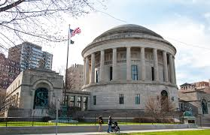
THE GRAND LODGE
Issues And Revokes Lodge Charters
Operates www.Elks.Org
Website
Promulgates GL Statutes, Constitution & By-laws
Operates As A
501 (C) (3) Non-profit
Located in Chicago, IL

Slide 5
GL ORGANIZATIONAL STRUCTURE
Executive – Includes PGERs, GER, DDGERs, Local Lodges Officers
Judiciary – Grand Forum, Judicial Committee, Trial Board, Local Lodge Forums And Mediators
Legislative – Lodge Members Meeting In Convention, Members Of Local Lodges

Slide 6
STATE ASSOCIATION STRUCTURE
Provides Advice And Leadership
To Help Your Lodge Succeed
State Sponsor (PGER) State Association President
State Association Officers PSP & District Leaders
State VPs State & District Committee Chairs
State Association By-Laws Training & Information
State Project (Camp Barrett)
William Jernick Fund - IRS 501 (C) (3)

Slide 7
LOCAL LODGE STRUCTURE
Operates Under Local By-laws & GL Statues
Membership
Exalted Ruler (President)
Chair Officers (Vice Presidents)
Board of Directors/Trustees
Elected & Appointed Officers
House Governing Body
Committees/Committee Chairs
IRS 501 (C) (8)

Slide 8
LEADERSHIP
AND
VOLUNTEERISM
Leadership is the capacity or ability to lead others.

Slide 9
Who Are Our Leaders?
Lodge Officers
Committee Chairpersons
GER, DD, SP, VP, ER, PERs,
PSPs, PVPs, PDDs
ALL MUST TAKE A LEADERSHIP ROLE FOR US TO BE SUCCESSFUL

Slide 10
Working With Volunteers Requires Some “Different” Leadership Skills
“Ordinary People Can Make An Extraordinary Difference By Providing Effective Leadership While Working With Unpaid Volunteers”.

Slide 11
LEADERSHIP OF VOLUNTEERS 101
Make Volunteers Feel Comfortable
Treat Them With Respect
Appreciate Their Work
Get To Know Them As Individuals
Introduce Them To Others
Offer To Help, But Let Them Do It Their Way
Give Them Recognition…Often!

Slide 12
LEADERSHIP OF VOLUNTEERS 101
Put Yourself In Their Shoes
Listen More Than You Talk
Don’t Blame, It May Be Your Fault
Communicate - Tell Them What Is Expected, Not How To Do It
THANK PUBLICLY - CRITICIZE PRIVATELY

Slide 13
LEADERSHIP OF VOLUNTEERS 101
Be Patient
Be Fair
Be Decisive
Be Consistent
Be Helpful
Be Thankful

Slide 14
LEADERSHIP OF VOLUNTEERS 101
Delegate Does Not Mean …”DUMP”
Delegate Means
You Trust Them
You Give Them Ownership
You Let Them Do The Job

Slide 15
PEOPLE VOLUNTEER FOR RECOGNITION AND APPRECIATION
Thank Them At Meetings
Print A “Thank You” In
Your Lodge Bulletin
Award Certificates Or Plaques
Do It Regularly

Slide 16
Leadership
YOU Can Be A Great Leader And
Grow Your Membership
Grow Attendance At Meetings
Grow Elkdom In Your Community

Slide 17
WHO ARE YOUR VOLUNTEERS?
Lodge Officers
Lodge Trustees
Lodge House Committee
Special Events Workers
Set-Up Workers
Maintenance Helpers
Many, Many Others

Slide 18
HOW AND WHEN DO WE
CONTACT VOLUNTEERS?
Emphasize Volunteerism At Orientation
Give Them A Form To Express Their Interest
Follow-up With A Phone Call
Track Volunteers Via Spreadsheet,
Phone-log, Etc
Invite Them To Volunteer For A
Specific Event
Greet Them When They Arrive
Thank Them For Their Help

Slide 19
WHO DOES ALL THAT STUFF?
The Team, That’s Who!
The ER And Other Lodge Officers
House Committee Chair And
Other Members
Lodge Volunteer Coordinator*
Other Active Volunteers
ANYONE Who Has The Interest Of The Lodge At Heart

Slide 20
VOLUNTEER DO’S AND DON'TS
DO NOT Ever Tell A Volunteer That You Do Not Need Them. Do Than Once And You Will Never See Them Again
Do Reward Your Volunteers…Free Drink Or A Free Meal (If Appropriate)
Do Not Let Negative Members “Infect” Your Volunteers

Slide 23
TEAM BUILDING

Slide 24
TEAM BUILDING
Characteristics Of A Team
Cooperation
Communications
Common Goals
Commitment To Common Goals
Draws Upon Each Person’s Talents
Provides A Consistent Decision Making Environment

Slide 25
TEAM BUILDING
EVERYONE IS IMPORTANT
Your Challenge Is To Find Out
How To Best Use The Talents Of Each Individual Toward Your Goal

Slide 26
LEADERSHIP IN THE LOCAL LODGE
Elected and Appointed Officers
The Board of Directors
The House Committee
Appointed Committee Chairs
PERs Association
Each Has Different And Distinct Authority And Responsibilities

Slide 27
LODGE LEADERSHIP TEAM
NEEDS TO KNOW:
THE SCOPE OF THEIR RESPECTIVE AUTHORITIES, DUTIES AND RESPONSIBILITIES
WHAT IS REQUIRED OF THEM AND
OF OTHER MEMBERS OF
LODGE LEADERSHIP

Slide 28
LEADERSHIP IN YOUR LOCAL LODGE
LEADERSHIP TEAM SHOULD BE FAMILIAR WITH THESE GRAND LODGE MANUALS.
ERs, OFFICERS & COMMITTEE MEMBERS MANUAL – (#510500)
GUIDE FOR BOARD OF DIRECTORS – 9JCBOD)
HOUSE COMMITTEE HANDBOOK – (HOUSE)
THEY ARE EASILY DOWNLOADED FROM THE WWW.ELKS.ORG WEBSITE.

Slide 29
LOCAL LODGE GOVERNANCE

Slide 30
THE EXALTED RULER MUST
Attend DD Clinics And Perform Any Duty As Outlined By The GLS Or Lodge By-laws (12.020)
Attend all Workshops/DDGER Clinics, and
MD, DE, and DC State Conventions
Appoint Esquire, Chaplain, Inner Guard, Tiler, And Organist (Optional) (12.010)
Appoint A Mediator And Presiding Justice Of The Subordinate Forum (13.020)
Appoint All Committees With Minimum Of 3 Members Each, including the House Committee(13.020)
Ensure Club Facilities Are Closed During All Special And Regular Meetings (Statute 16.090)

Slide 31
THE EXALTED RULER MUST
Be An Ex-officio (Without Vote) Member Of The Board Of Trustees, And Should Attend All Meetings (12.020)
Retain The Only Key For The Subordinate Forum Box (8.040) & See That Trustees And Secretary Draw Names As Outlined By GLA In June And December (1.210)
Attend The GL Convention, Attend All Business Sessions, Submit A Report To The Lodge NLT First Regular Meeting In October Of Issues Presented At The Meetings (12.120)
Hold Regular Monthly Meetings With Lodge Officers
(Maybe Before Regular Meetings)
Attend All PER Association Meetings

Slide 32
THE EXALTED RULER SHOULD
Have Knowledge Of The Job Of Exalted Ruler
Set Goals For The Lodge And Form A Plan For Achieving Those Goals
Provide Strong Leadership
Meet Schedules And Reporting Deadlines
Communicate In A Clear And Concise Manner
Listen And Understand When The Membership Communicates With You
Be Familiar With Roberts Rules of Order

Slide 33
THE EXALTED RULER CANNOT
Control The Lodge Bar Or Kitchen Operation, But Can Be A Member Of The House Committee
Hire And/Or Fire Staff
Control Lodge Facilities Improvements,
Maintenance Or Repairs
Create Or Approve The Annual Budget
Control The Finances Of The Lodge
Direct That Expenditures Be Made
Interfere With The Duties Of The Lodge Secretary Or Treasurer

Slide 34
BOARD OF DIRECTORS MUST
Be Comprised Of The Exalted Ruler, The Three Chair Officers, And The Trustees Of The Lodge (12.070)
Elect Its Own Chairman And Secretary
Prepare And Present A Detailed Budget For Lodge Approval NLT The Last Meeting In April
Conduct Its Business At Regularly Scheduled Monthly Meetings And Give Notice Of
Meetings Open To Members

Slide 35
BOARD OF DIRECTORS MUST
Control The Property, Funds And Investments Of The Lodge, Subject To The Approval Of The Members
Act At The Direction Of The Membership
Be Aware Of And Observe GL Restrictions On Spending For Large Capital Projects
Conduct An Annual Inventory Of Lodge Property

Slide 36
BOARD OF DIRECTORS MUST
Take Minutes Of All Meetings And Make Them Available To The Membership
Establish And Maintain An Accident Prevention Program and Appoint A Member As Manager
Cooperate With The Activities Of The Auditing & Accounting Committee
Monitor Revenues And Expenditures For Budget Compliance
Be Mindful That Other Lodge Officers Have Their Own Statutory Duties And Responsibilities That May Not Be Violated Or Abridged

Slide 37
BOARD OF DIRECTORS SHOULD
Be Conscientious Of Their Responsibility To Monitor All Lodge Activities
Approve And Oversee Rental Arrangements For Lodge Facilities, Unless Other Provisions Are Made In The Lodge Budget

Slide 38
BOARD OF DIRECTORS SHOULD
Conduct Their Meetings In Accordance With Robert Rules Of Order, As Modified By Lodge By-laws
Understand That The BoD Is A Separate Entity From Any Other Office Or Committee Its Members May Serve On

Slide 39
BOARD OF DIRECTORS CANNOT
Refuse To Consider Items Of Business Proposed By A Member Of The Board
Spend Money Without The Prior Approval Of The Members Of The Lodge

Slide 40
BOARD OF DIRECTORS CANNOT
Exert Authority Over The Operation Of The Club Facility (GL Statute 16.040)
Implement Proposals Approved By BoD Before They Are Approved By The Lodge
Hire And Fire Employees

Slide 41
THE HOUSE COMMITTEE
OFFICERS AND OTHER APPOINTMENTS

Slide 42
HOUSE COMMITTEE MUST
Elect A Secretary
Hold Scheduled Monthly Meetings And Notify the ER and Members Of The Time And Place
Keep & File With The Secretary, Minutes Of Those Meetings
Be The Governing And Supervisory Body For Lodge Bar And/Or Kitchen Facility - Hire And/Or Fire Staff

Slide 43
HOUSE COMMITTEE MUST
Set Prices For Goods Sold In That Facility
Provide A Budget For The Facility NLT
The Last Meeting in April

Slide 44
HOUSE COMMITTEE SHOULD
Follow Sound Business Practices
Enforce The Lodge’s Approved
House Rules
Manage The Daily Operation Of The Club
Always Act In The Best Interest Of The Lodge And Its Members
Present A Monthly Financial Report
To The Lodge

Slide 45
HOUSE COMMITTEE SHOULD
Conduct A Monthly Inventory Of
Food, Alcohol, Etc.
Purchase Supplies As Needed For
Club Operation
Manage The Social Activities Of The Club

Slide 46
HOUSE COMMITTEE CANNOT
Purchase Furniture or Equipment Without Approval From The Membership
Hire Any Lodge Officer or Member Of The Committee To Be A Paid Employee
Deviate From GLS 16.041 In Suspending Or Otherwise Disciplining A Member

Slide 47
P.E.R. ASSOCIATION
The P.E.R. Association Is Valuable To Any Lodge, And Is Required By Grand Lodge (13.190)
They Shall Hold Regular Meetings
Because Of Their Knowledge, They Should Assist The Exalted Ruler
They Should Elect Their Own Officers
They Should Offer Suggestions As To Members That Will Make Good Committee Members And Officers

Slide 48
Committee Chairpersons
Strong committee chairpersons are vital to the success of the lodge, and should be selected wisely
Each committee by statute should have a minimum of three members (13.020)
“Progress” or “No Report” should not be accepted as a committee report
Need to attend District meetings to get the overall committee objectives

Slide 49
Local Lodge Committees
Americanism 13.022 Auditing 13.040
Drug Awareness 13.021 Flag Day 2.030, 13.022
Hoop Shoot 13.021 Lodge Activities 13.022
Membership 13.022 Memorial Day 13.022
Elks National Foundation 13.022
Nat. Vet. Service 13.022
Public Relations 13.024
Community Activities 13.021
Youth Activities 13.021

Slide 50
Local Lodge Committees
There Are Specific Lodge Committees Which The ER Shall Appoint (13.020)
Committee Chairs Should Hold Regular Meetings, Present Reports To The Lodge, And Document Committee Activities

Slide 51
Local Lodge Committees
Lodge-specific Committees Include: Sickness & Distress, Bulletin, By-laws, Investigation, Indoctrination, Etc.
Without Committee Work, The Lodge Has No Purpose Or Reason For Existence. Committees Do The “Work Of Elkdom”

Slide 52
Standing Relief Committee
Consists Of Exalted Ruler, The 3 Chair Officers, Secretary & Treasurer
They Shall Examine The Merits Of All Cases Suggesting The Necessity Of Aid Or Relief
Names Of Members Seeking Relief Should Be Confidential
Lodge Must Vote On The Appropriations
Motion For Such Requests May Be Made By Any Member

Slide 53
OFFICER POSITIONS
All Officer Positions Are Important!
Strong Leadership = A Strong Lodge
The Exalted Ruler Is The CEO And Is Ultimately Responsible For All Lodge Activity
All Officers Should Enforce
“House Rules”
If You’re Not Sure Of Something, ASK! The PERs Are A Great Source Of Guidance

Slide 54
PRESIDING JUSTICE OF THE SUBORDINATE FORUM
Appointed By The Exalted Ruler (13.020)
Should Be A Lawyer, If Available
Need Not Be An Officer, Need Not Be Installed and Need Not Be A Member Of Your Lodge

Slide 55
Presiding Justice Of The Subordinate Forum
Has Jurisdiction Over All Cases Involving An Offense Committed
Against The “Laws Of The Order” By A Member Of The Lodge
Presides at Local Forum Hearings

Slide 56
Mediator
Need Not Be A Lawyer.
Should Have Knowledge Of Statutes
Should Understand Laws On Discrimination, Harassment, etc.
Should Refrain From Conversation With Anyone Involved In A Pending Case

Slide 57
Mediator
Must Be Impartial Or Remove Themselves If They Can Not Be
Mediator Must Be Informed Within 2 Days Of The Filing Of A “Notice Of Intent”
Shall Set Up A Meeting Between The Accused And The Accuser Within 5 Days Of Filing Of Notice

Slide 58
Mediator
Only The Mediator, The Accused, The Accuser, And Their “Council” Are Permitted To Attend The Mediation
No Record Of The Proceedings Of The
Mediation Are Kept
The Mediator MUST Control The Session

Slide 59
Mediator
It Is The Objective Of Mediation That A Solution To The Issue Be Achieved
At Conclusion, Mediator Must Submit A Written Statement To The Secretary Of His Findings - Resolved Or Unresolved

Slide 60
COMMITTEE OVERSIGHT - EXALTED RULER
Auditing And Accounting Committee
Accident Prevention Committee
PERs Association
Standing Relief Committee
Ritual
Elks Camp Barrett
House Committee
Building & Grounds

Slide 61
COMMITTEE OVERSIGHT
LEADING KNIGHT
Americanism
Elks National Foundation
Flag Day
Memorial Day
Membership
Lodge Activities
Veterans Services

Slide 62
Committee Oversight - Loyal Knight
Activities Committee
Community Projects & Activities
Youth Activities
Hoop Shoot
Soccer Shoot
Drug Awareness
Public Relations Committee
Scholarship Committee

Slide 63
COMMITTEE OVERSIGHT LECTURING KNIGHT
Government Relations Committee
Food (Special Events) Committee
Bulletin Committee
Entertainment Committee

Slide 64
SOME PROBLEMS TO WATCH FOR
Failure To Maintain A Sound Financial Condition
Lodges Without Solid Officer Slates (PERs In Chairs)
Lack Of A PER Association
Non-Functioning Committees
Unauthorized Or Illegal Activities
Illegal Gambling
Using Dedicated/Charity Funds For Other Than What They Were Intended
Sexual Harassment And Discrimination
Club Operators Violating State Liquor Laws Not Following State ABC Guidelines
House Rules Not Approved By Grand Lodge

Slide 65
ELKS SOCIAL MEDIA RULES
Nothing mean spirited, Hateful, libelous, obscene or Explicit
No personal attacks or profanity
Keep Lodge information off the web!
Don’t violate laws or encourage others too
Nothing discriminatory
No photos of members drinking, smoking or anything harmful to the Elk image
No photos of minors without signed consent from parents.
Never post the names of a child unless they are the reason for the photos
Don’t publish your bulletins or newsletters on a website open to the public

Slide 66
FINANCIAL REPORTING SYSTEM (FRS)
Mandated by Grand Lodge Statute Section 13.040
Person in charge of FRS (usually Treasurer)
Lodges that are compliant with FRS reporting are not required to have their financial statements reviewed or audited by an outside accountant for the Grand Lodge
Lodges pays an annual user access fee of $165 per year
Lodges do not have direct access to the data stored in FRS. Receive viewer access to FRS reports for an additional fee of 380.

Slide 67
Submit budget report to FRS (usually due in May)
Lodges must use the Grand Lodge Uniform Chart of Accounts
Monthly financial submissions are due by the third Friday of the following month. Late submissions, after an approved extension could be subject to fines of up to $100 per month for up to 5 months
Financial data submitted monthly to FRS is cumulative. This is so that changes made to prior month’s data will be captured. By the end of the year, this will be a very large report
Update budget projections if income is falling below anticipated levels

Slide 68
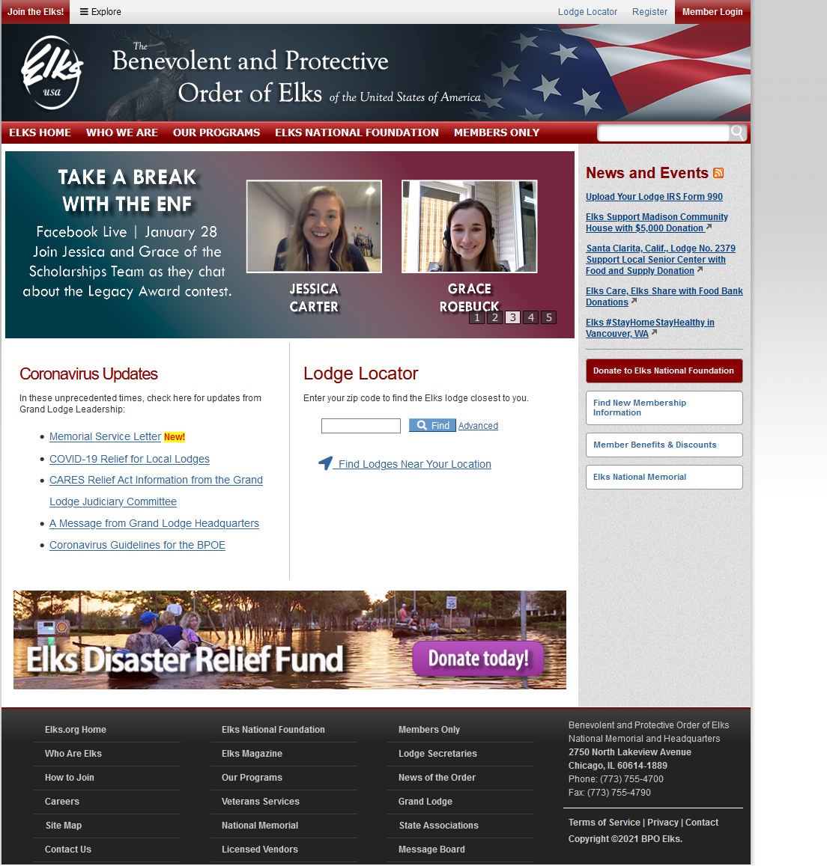
www.elks.org

Slide 69
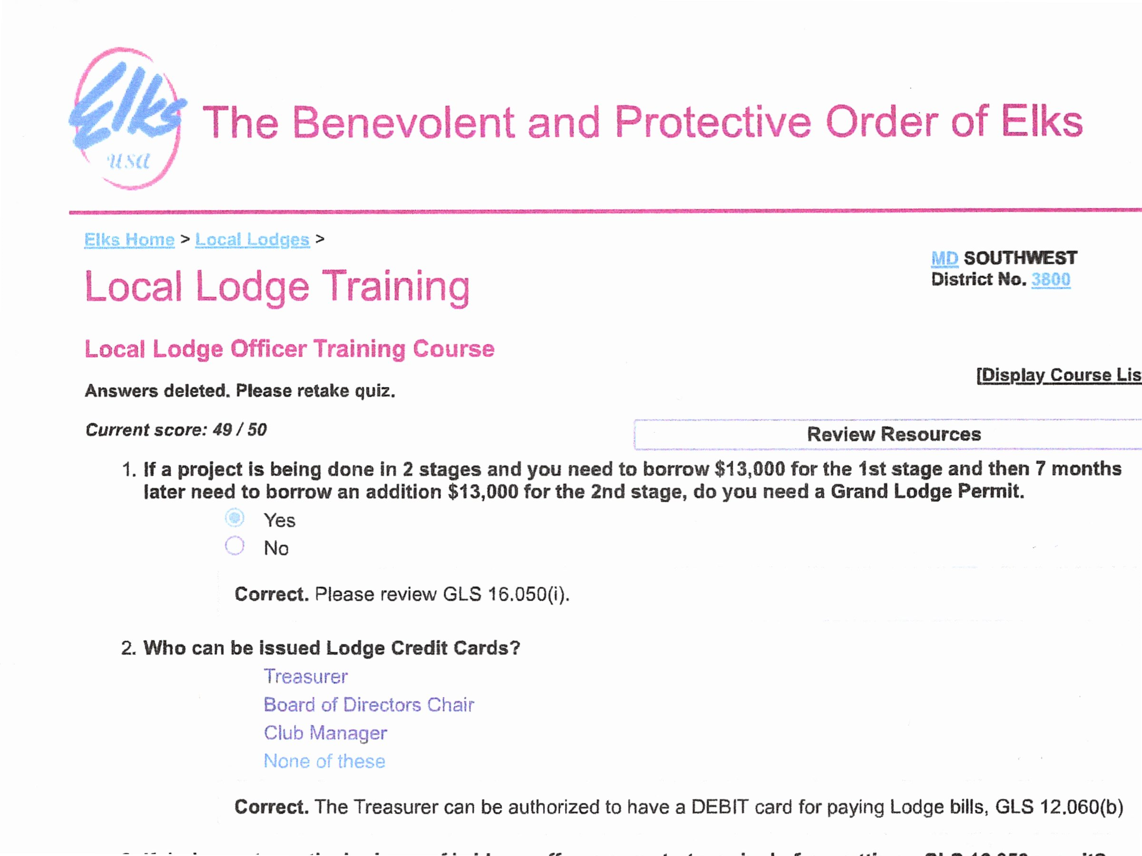

Slide 70
www.mddedcelks.org

Slide 71
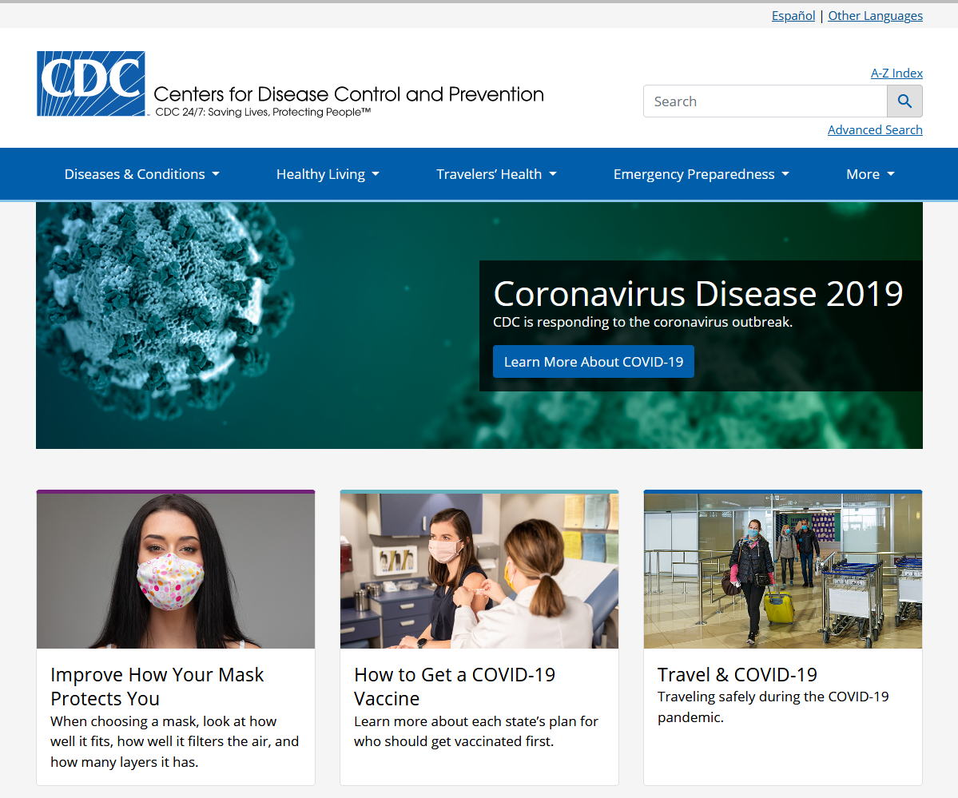
www.cdc.gov

Slide 72
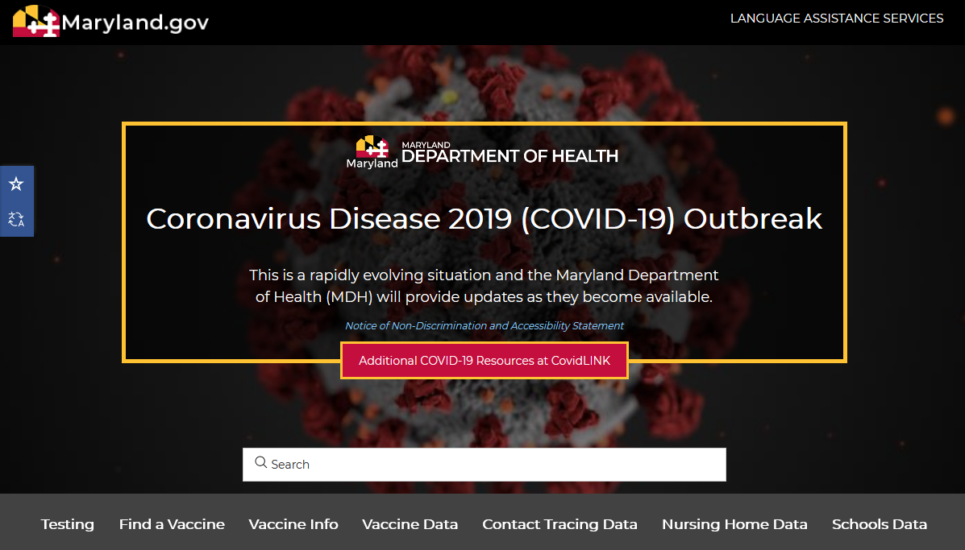
www.coronavirus.maryland.gov

Slide 73
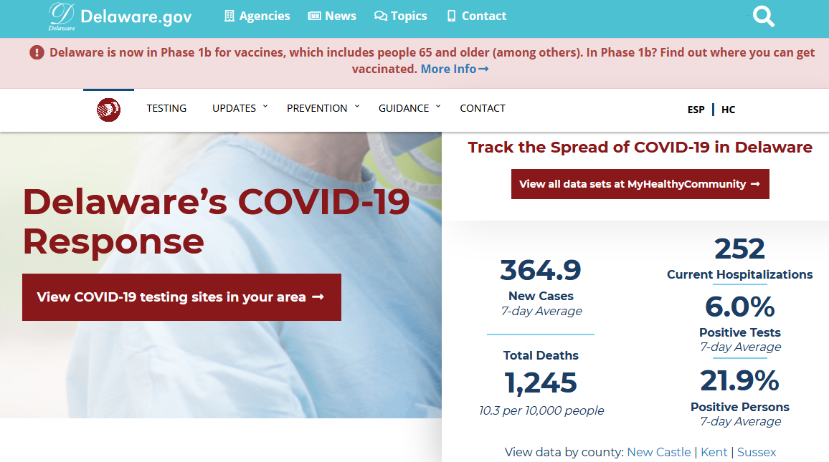
www.coronavirus.delaware.gov

Slide 74
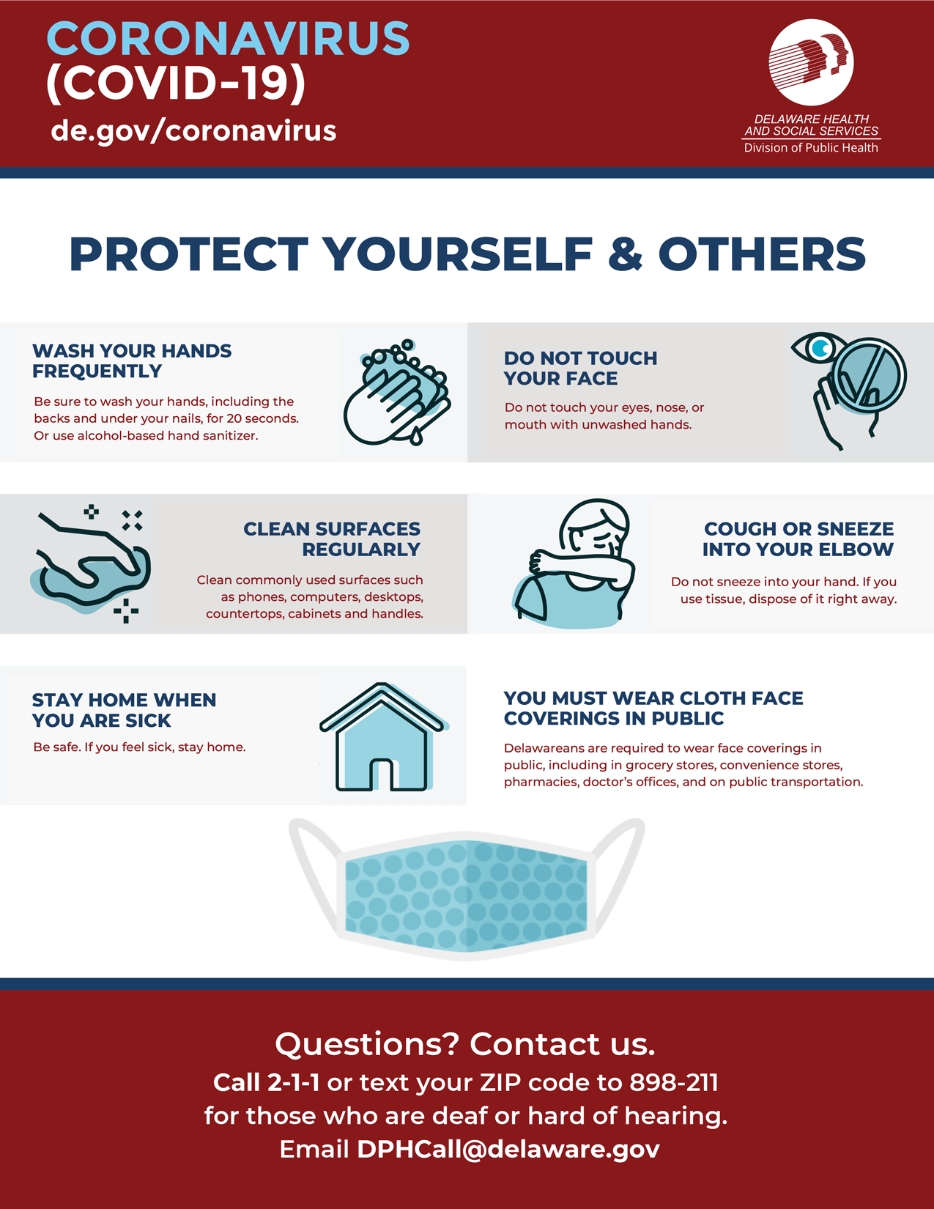
LEARN TO PROTECT YOUR LODGE

Slide 75
The Fraternal Committee:
Indoctrination/Orientation
Of
Candidates

Slide 76
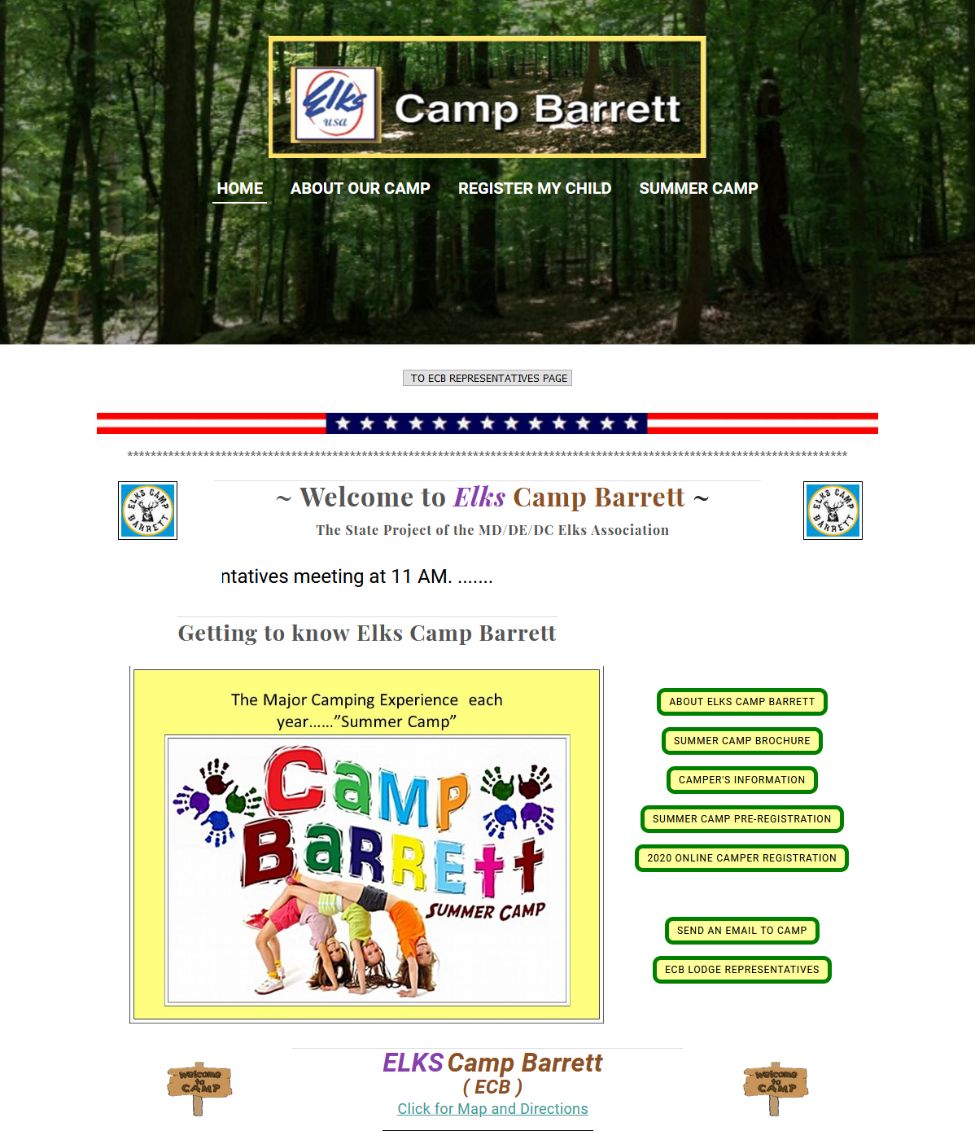
www.elkscampbarrett.org

Slide 77
PLANNING
AND
BUDGETING

Slide 78
IMPORTANCE OF PLANNING
AND BUDGETING
“In Preparing For Battle I Have Always Found That Plans Are Useless, But Planning Is Indispensable.”
General Dwight D. Eisenhower

Slide 79
Annual Calendar Development
Plan your entire year on a calendar with your officers and committee members
Begin with GL Calendar already populated with Grand Lodge events on specific dates
Use Exalted Ruler, Lodge Officers, Committee Members Handbook
Use State Association Directory for future events – know the conference and workshop dates – plan local lodge events around them
Use local Lodge knowledge to plan meetings, events, and activities

Slide 80
List of References
Grand Lodge Statutes 2020
Elks Drug Awareness Manual
ENVSC Manual
Guide For The Board Of Directors
House Committee Handbook
Membership Program and Planning
All are available at www.elks.org or www.mddedcelks.org

Slide 81
List of References
ERs, Officers and Committee Members Manual
Rituals of Local Lodges
Youth Activities Programs Manual
Uniform Chart of Accounts
Auditing and Accounting Manual
All are available at www.elks.org or www.mddedcelks.org

Slide 82
ADDITIONAL REFERENCES
Local Lodge By-Laws
MD, DE & DC Elks Assn By-Laws
Manual For The Secretary
Elks.org User Manual
Grand Lodge Program 2021-2022
All are available at www.elks.org or www.mddedcelks.org

Slide 83
TRAINING CLOSE-OUT

Slide 84
TRAINING TAKE-AWAYS
Critically Think Through Tough Decisions Using The Overall Elks Organizational Intent
Why Are We An Organization?
Who Are Our Stakeholders?
How Do We Interact With Our Stakeholders?
Plan Your Year For Optimal Chance At Success
Use An Annual Calendar To Plan Your Year – GL Dates, SA Dates, LL Dates (All Important)
Every Year; Plan For 5 Years – Leadership = Vision
Involve The Successive Leadership So There Is
Buy-in To Continue
Meet With Officers At Least Monthly, But Bi-weekly If Possible, To Keep Communication Open

Slide 85
TRAINING TAKE-AWAYS
Use Grand Lodge Resources – All On Www.Elks.Org
Especially Exalted Ruler, Lodge Officers, And Committee Members Manual
List Of Resources Handout
Essential To Familiarize Yourself With GL Website
Committees Are Important As Spokes On A Wheel
Lodge Success Is The Hub
Membership And Financial Stability Are The Foundation
Community Outreach Within Committee Programs Create More Membership And Financial Stability – Continuous Loop
Have Fun With Your Team!!!

Slide 86
Training Survey
Give us the The Good, The Bad, and The Ugly
This committee wants to continuously improve
Please take a few minutes to complete

Slide 87
Thank You For Your Time and Attention.
I Can Be Reached at 240-508-8636 Or rrivituso@hotmail.com
Renee’ Rivituso,PDDGER
Elks Training Chair

